Slide 1

World Happiness Project
Jason Cook
Amon Jean
Michael Park
Tammy Ura-Aguilar

Slide 2
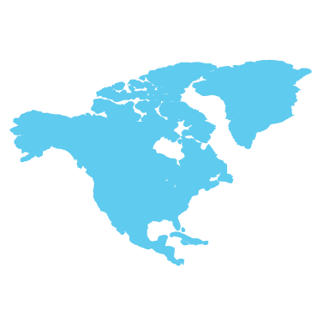
World Happiness Report
The World Happiness Report is a landmark survey of the state of global happiness. The reports review the state of happiness in the world today and show how the new science of happiness explains personal and national variations in happiness. Ranks 155 countries by their happiness levels; released at the United Nations at an event celebrating International Day of Happiness on March 20th. The report continues to gain global recognition and is used to describe how measurements of well-being can be used effectively to assess the progress of nations.

Slide 3

How is Happiness measured?
The happiness score and ranking use data from Gallup World Poll. The scores are based off of The Cantril Self-Anchoring scale, that consists of :
Respondents imagining a ladder with steps numbered from zero at the bottom to 10 at the top.
The top of the ladder represents the best possible life for you and the bottom of the ladder represents the worst possible life for you.
On which step of the ladder would you say you personally feel you stand at this time?
3

Slide 4

Six factors for Life Evaluation:
Economic production - GDP per capita in purchasing power parity (PPP); adjustment factor of 1.17 between 2005 PPP to 2011 PPP to account for changes in implied prices
Social support - national averages of binary answers (0 or 1) in response to “Do you have someone to count on in times of trouble?”
Life expectancy - World Health Organization (WHO) data repository
Freedom – national average of responses to “Are you satisfied with your freedom to make life choices?”
Absence of corruption – average of 2 (0-1) responses regarding corruption
Generosity - residual of regressing national average of response to the GWP question “Have you donated money to a charity in the past month?” on GDP per capita
4

Slide 5
Data Cleanup & Analysis
We had to merge 5 World Happiness csv files
We realized not every year had the same amount of countries, columns, and country names
5 countries did not have the same spelling through the files, so we renamed them to match.
20 countries were not in every year
Removed all the the NaNs
Removed columns that were not in every file
Renamed columns names to match all the files
Countries Not in Every Year
Angola | Namibia
Belize | North Macedonia
Central African Republic | Oman
Comoros | Puerto Rico
Djibouti | Somalia
Gambia | Somaliland region
Laos | South Sudan
Lesotho | Sudan
Macedonia | Suriname
Mozambique | Swaziland
Name | Rename to match other files
Hong Kong S.A.R., China | Hong Kong
Taiwan Province of China | Taiwan
Trinidad and Tobago | Trinidad & Tobago
North Cyprus | Northern Cyprus
Somaliland region | Somaliland Region

Slide 6
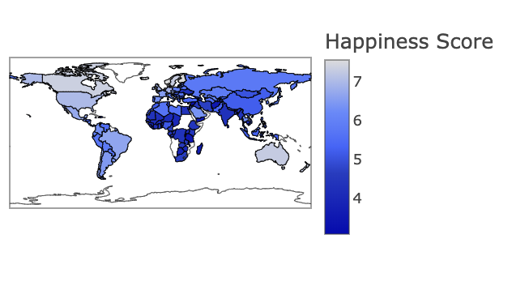
Average Happiness Score
6

Slide 7
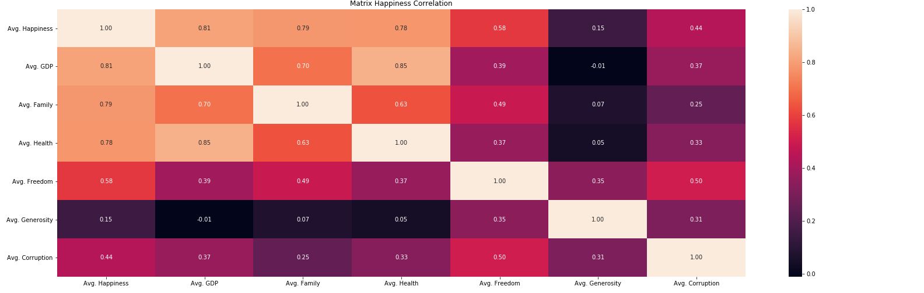
World Happiness Correlation Matrix
7

Slide 8
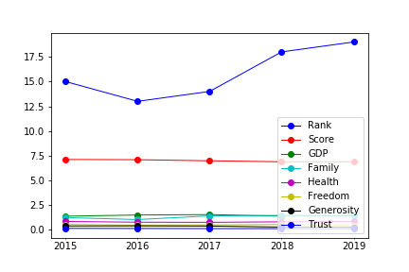
US Happiness Over Time
8

Slide 9
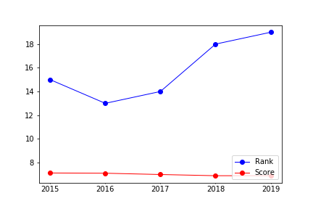
US Rank and Score Over Time
9

Slide 10
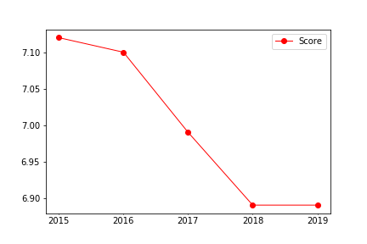
US Happiness Score Over Time
10

Slide 11
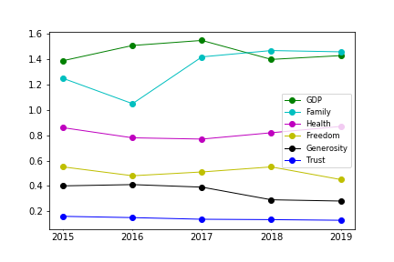
US Happiness Factors Over Time
11

Slide 12
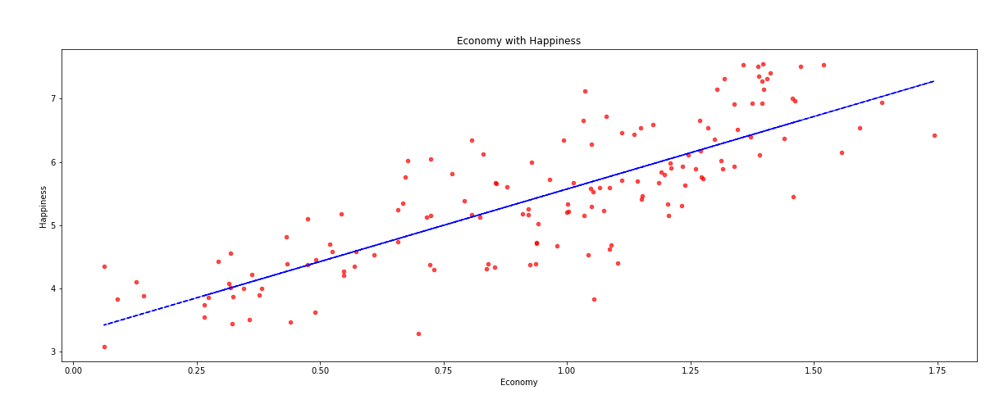
Economy to Happiness Scatter plot with regression line fit
Slope = 2.29
12

Slide 13
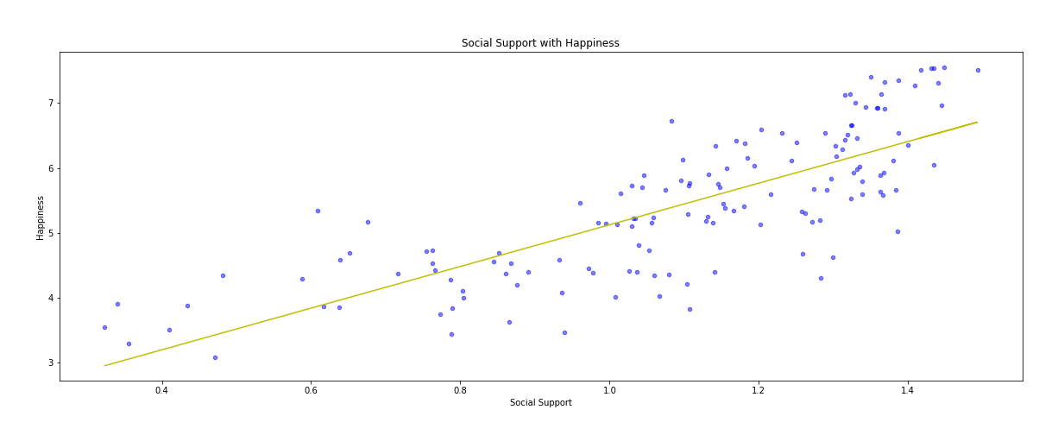
Social Support to Happiness Scatter plot with regression line fit
Slope = 3.21
13

Slide 14
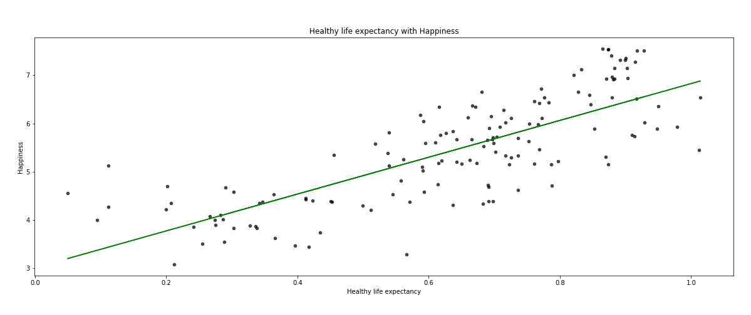
Life Expectancy to Happiness Scatter plot with regression line fit
Slope = 3.81
14

Slide 15
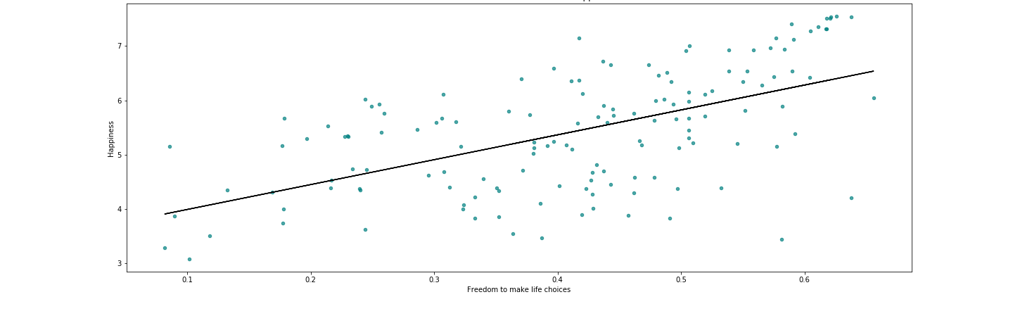
Freedom to Happiness Scatter Plot with regression line fit
Slope = 4.81
15

Slide 16
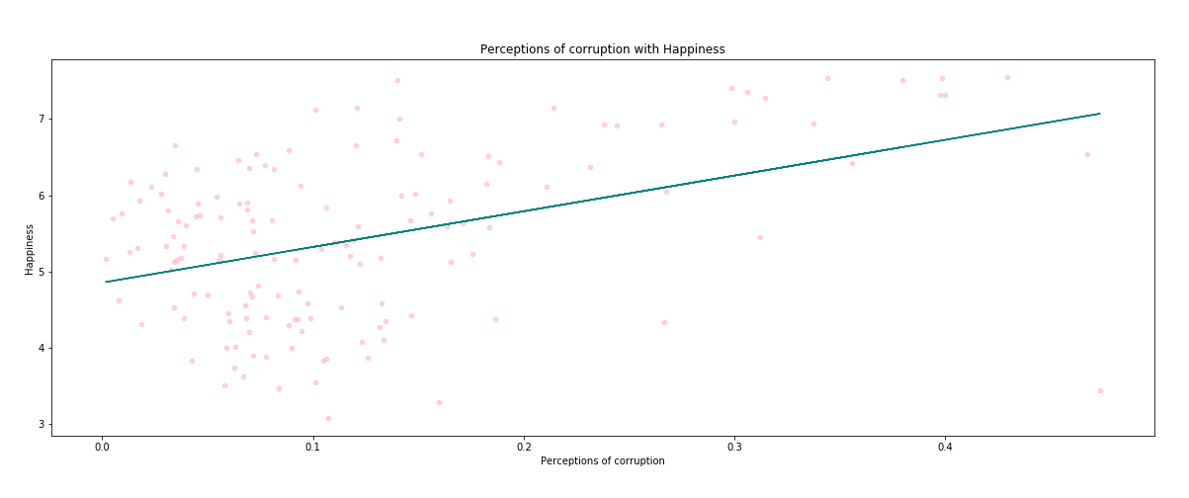
Corruption to Happiness Scatter plot with regression line fit
Slope = 4.68
16

Slide 17
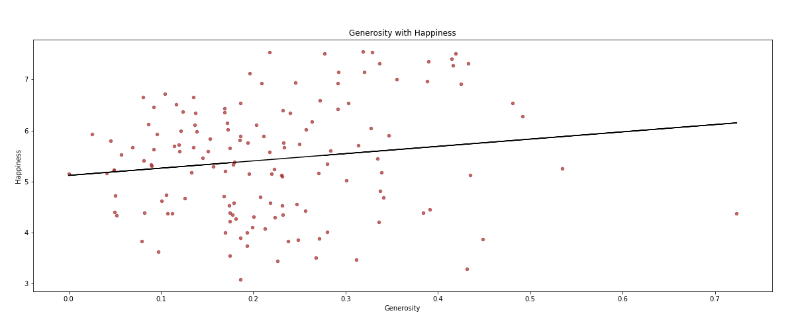
Generosity to Happiness Scatter plot with regression line fit
Slope = 1.42
17

Slide 18
Factors by Correlation
Trust = 4.68
Freedom= 4.58
Health= 3.81
Family= 3.21
GDP= 2.29
Generosity= 1.42
18

Slide 19
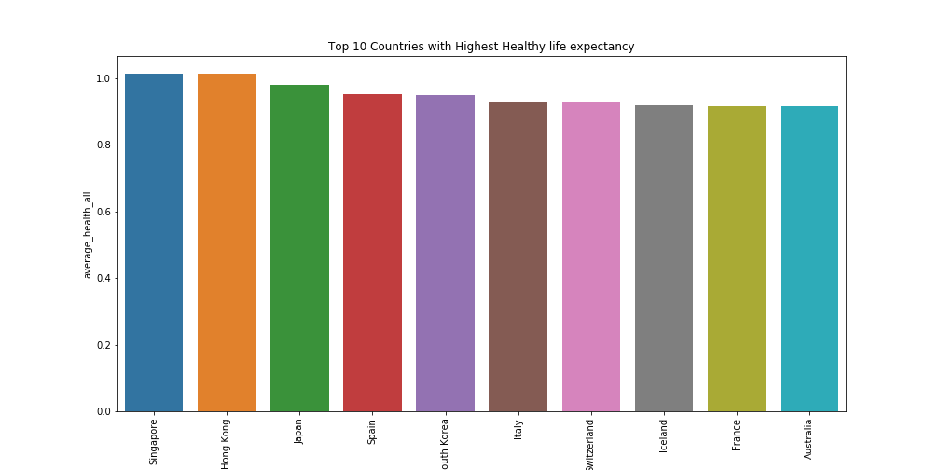
Top 10 Countries with Highest Health Life Expectancy
19

Slide 20
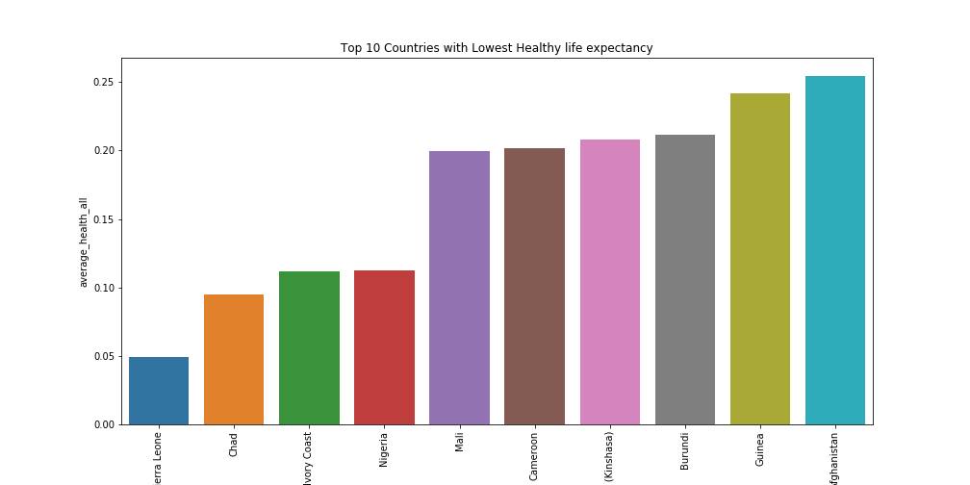
Top 10 Countries with Lowest Health Life Expectancy
20

Slide 21
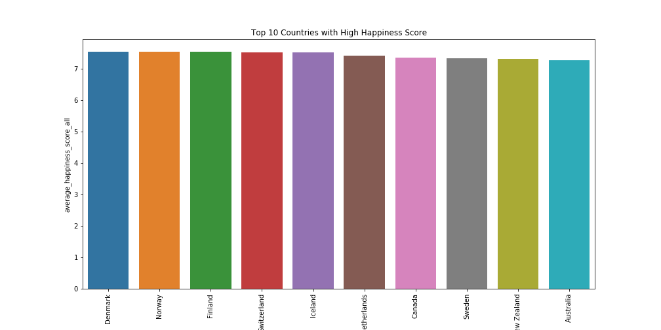
Top 10 Countries with Highest Happiness Score
21

Slide 22
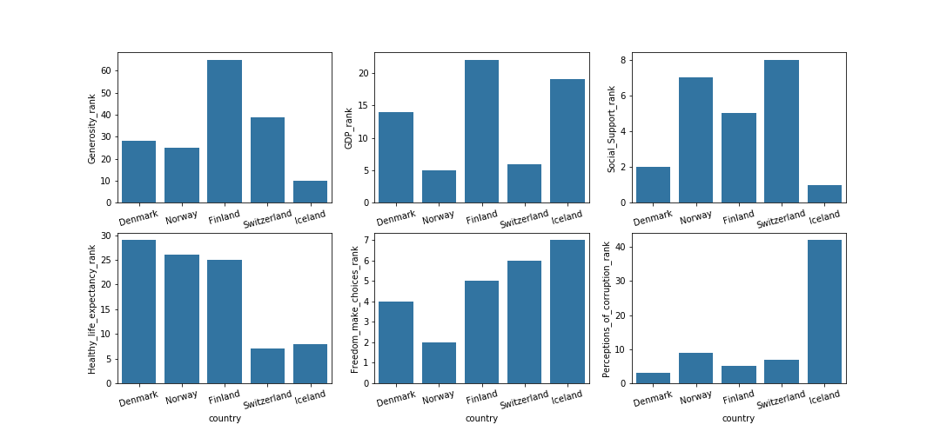
Top 5 Countries with Highest Happiness Score by Factors
22

Slide 23
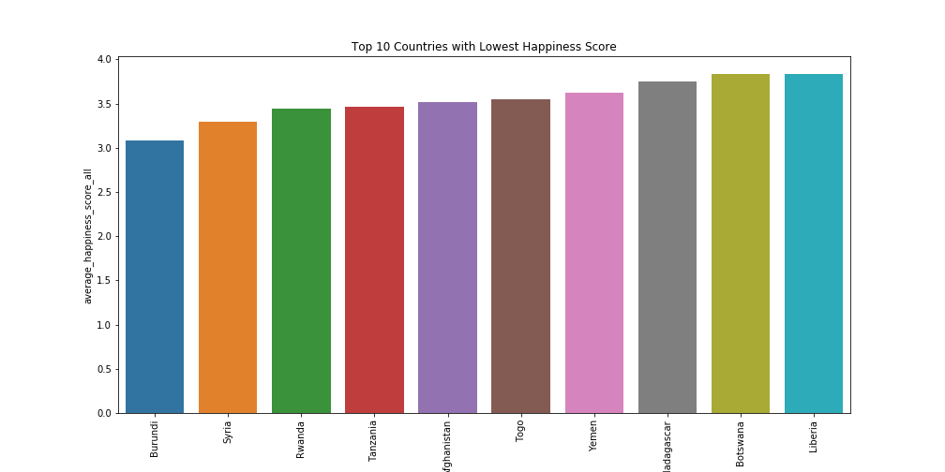
Top 10 Countries with Lowest Happiness Score
23

Slide 24
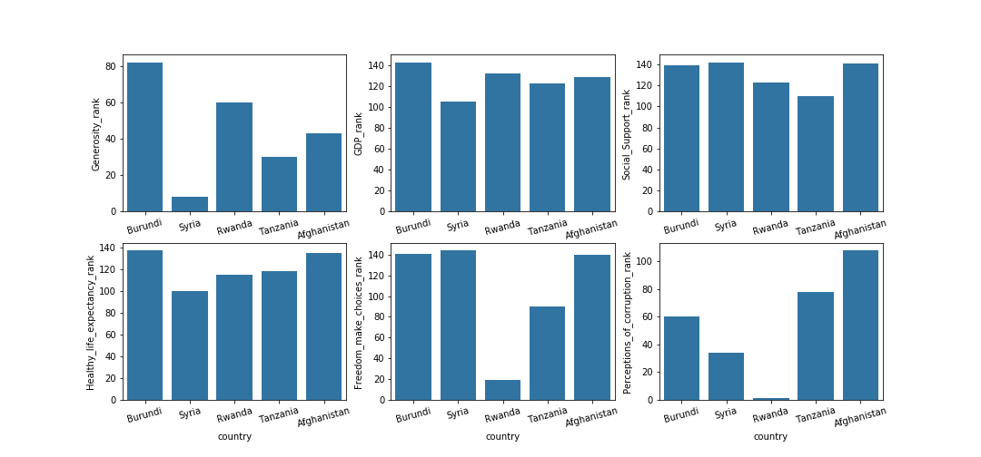
Top 10 Countries with Lowest Happiness Score
24

Slide 25
Conclusion
From our Happiness Report Analysis, we can conclude that Happiness correlates with Economic production (GDP), Social support or family, Life expectancy or health, Freedom, Generosity, and Perception of Corruption. Generosity and perception of corruption was the lowest of the six factors from the Matrix Happiness Correlation graph.
From all the graphs above, it further proves that Economic production (GDP), Social support or family, Life expectancy or health, and Freedom all correlated with the overall happiness score while Generosity loosely correlated with the overall happiness score and finally, Perception of Corruption correlated the least with overall happiness.
It was very telling that from the list of top five average happiness scores from the past five years, all five countries are relatively close to one another in Europe. Four of the five are Nordic countries ( Denmark, Norway, Finland, and Iceland). Switzerland was the only country that was not a Nordic country although it is relatively close.
For the bottom 5 for average happiness scores, three of the countries are in Africa very close together, Burundi, Rwanda, and Tanzania, while the other two are in the Middle Eastern region, Syria, and Afghanistan. Those five countries has had a lot of conflicts or poor healthcare and nutrition provided to their people.
In conclusion, overall happiness has many factors that contribute to a countries score. As It was suspected, Economy, family, health, and freedom has the highest correlation with the overall happiness score and generosity and perception of corruption had the lowest correlation with the overall happiness score. If you want to reach happiness, move to a Nordic Country!
25

Slide 26

For more information:
https://worldhappiness.report/

